Slide 1
NLM Reproducibility Workshop Virus Team
•Anjan
•Bari
•Julio?
•Nicole
•Steve

Slide 2
Papers Reviewed
•An optimized methodology for whole genome sequencing of RNA respiratory viruses from nasopharyngeal aspirates, PLOS One https://doi.org/10.1371/journal.pone.0199714
•concatenated references and software version numbers missing
•ELM: enhanced lowest common ancestor based method for detecting a pathogenic virus from a large sequence dataset https://www.ncbi.nlm.nih.gov/pmc/articles/PMC4124145/
•link to website that is supposed to have customized tools not functioning
•Nasopharyngeal microbiota in healthy children and pneumonia patients. - PubMed – NCBI
•VirusDetect: An automated pipeline for efficient virus discovery using deep sequencing of small RNAs
•Scalable metagenomic taxonomy classification using a reference genome database
•RNA viral metagenome of whiteflies leads to the discovery and characterization of a whitefly-transmitted carlavirus in North America. - PubMed - NCBI

Slide 3
Paper review cont.
•“Long-read transcriptome data for improved gene prediction in Lentinula edodes,”
•“Molecular characterization of Giardia lamblia in children less than 5 years of age with diarrhoea attending the Bengo General Hospital, Angola,” Transactions of The Royal Society of Tropical Medicine and Hygiene
•“Identification of Rare Causal Variants in Sequence-Based Studies: Methods and Applications to VPS13B, a Gene Involved in Cohen Syndrome and Autism,” PLOS Genetics
•“Long read nanopore sequencing for detection of HLA and CYP2D6 variants and haplotypes,”
•"New and emerging targeted therapies for cystic fibrosis," BMJ
•Recovering complete and draft population genomes from metagenome datasets. - PubMed – NCBI
•Phage hunters: Computational strategies for finding phages in large-scale 'omics datasets. - PubMed – NCBI
•VirFinder: a novel k-mer based tool for identifying viral sequences from assembled metagenomic data. - PubMed – NCBI
•iVirus: facilitating new insights in viral ecology with software and community data sets imbedded in a cyberinfrastructure
•Viral to metazoan marine plankton nucleotide sequences from the TaraOceans expedition
•Dinucleotide Composition in Animal RNA Viruses Is Shaped More by Virus Family than by Host Species
•Virome comparisons in wild-diseased and healthy captive giant pandas
Virus Identification in Unknown Tropical Febrile Illness Cases Using Deep Sequencing

Slide 4
Most Common Rejection Reasons
Proprietary software used
Customized tools created but links failed
Access to raw data missing
Too much missing information about pipeline/tools
Genome too large for three-day workshop

Slide 5
Winner
•Viromic Analysis of Wastewater Input to a River Catchment Reveals a Diverse Assemblage of RNA Viruses https://www.ncbi.nlm.nih.gov/pmc/articles/PMC5964442/
•Accession and contamination samples described
•Workflow included
Some confusion about positive and negative controls

Slide 6
Project Overview
Datasets:
Read and contig data sets are available from NCBI under the following BioProject accession numbers: PRJNA421889 (wastewater data), PRJNA421892 (sediment data), and PRJNA421894(estuarine water data). The NoV GI genome isolate was deposited in GenBank under accession number MG599789. However, raw data and controls were requested from first author and received in a less than 24 hour turn around.
Pipeline:
Snakemake using containerized tools

Slide 7
Challenges
Missing Data/Tools
NR files are from a different year
How do you define success, metrics use, amount of variation allowed, (e.g. group 2 - can we get to the same conclusions)

Slide 8
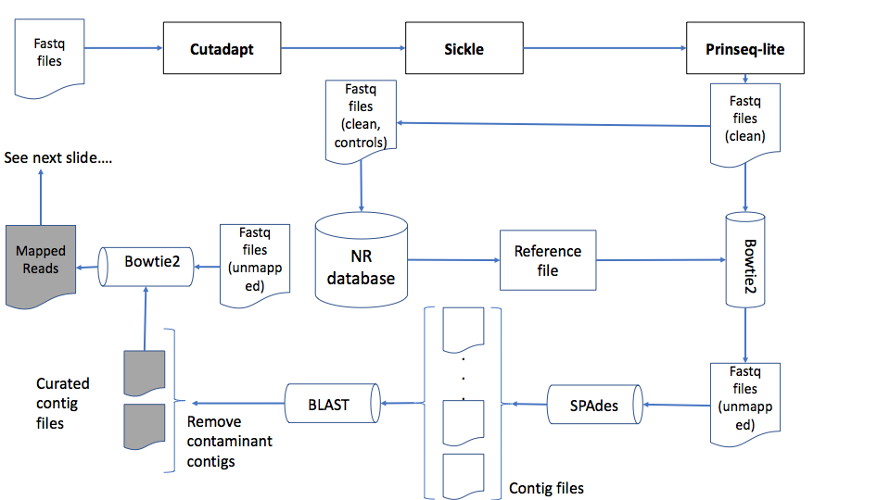

Slide 9
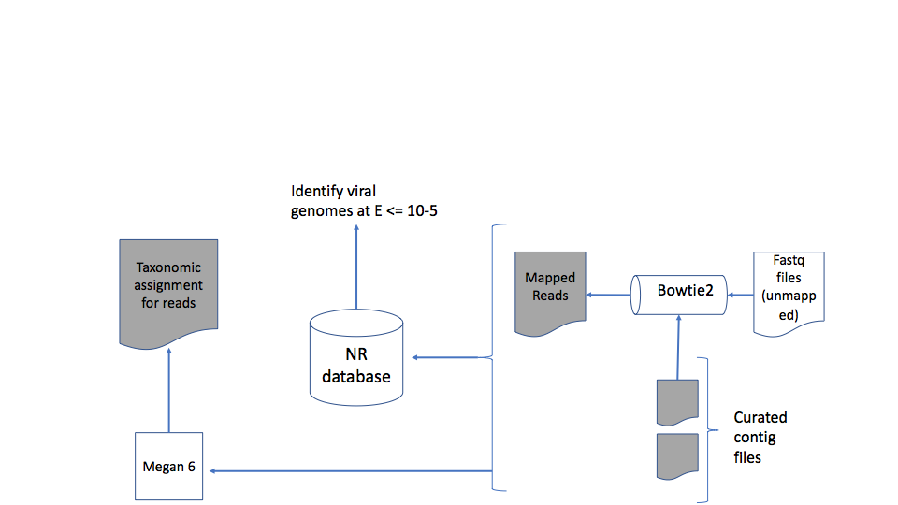

Slide 10
Containerization Challenges
Tool version/configuration/parameters not specified by the author
Tool documentation lacking details on dependencies
Familiarity with tools
Lack of test data
OS/platform-dependent or proprietary tools

Slide 11
Recommendations
In making your own research reproducible, ask a colleague not familiar with the project to recreate it from what you plan to include in the manuscript and supplemental materials.
When attempting to reproduce other’s published research, contact the authors to confirm you have what you think you have. We thought the accession numbers included raw data, but they did not.

